Slide 1
Types of cost
UNIT-4

Slide 2
1. Total fixed cost
The payment which are made by the producer on fixed factors during the process of production are know as total fixed cost.
Ex- land, machinery etc.
Other names of total fixed cost are supplementary cost, general cost, Indirect cost.

Slide 3
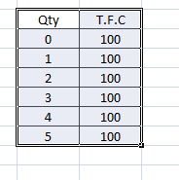
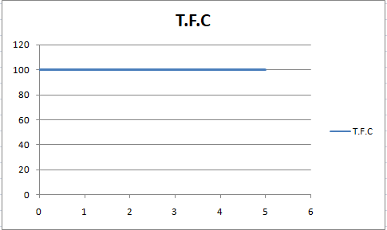

Slide 4
2. Total Variable Cost
The payments which are made by the producer on variable factors during the process of production are known as T.V.C
Examples :- raw material ,labour,fuel etc.
Other names are prime cost, avoidable cost, direct cost.

Slide 5
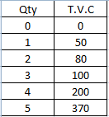
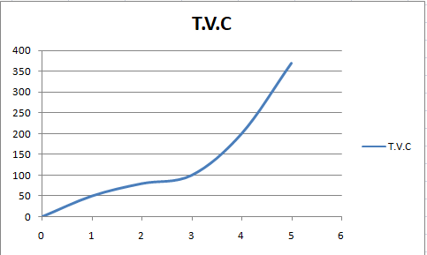

Slide 6
Total cost
It refers to the total expenditure which is paid on fixed as well as variable factor.
T.C = T.F.C +T.V.C

Slide 7
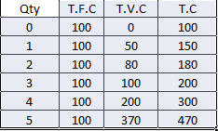
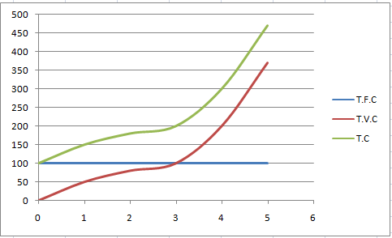

Slide 8
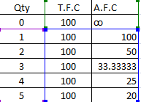
Average fixed cost A.F.C = T.F.C/ Q

Slide 9
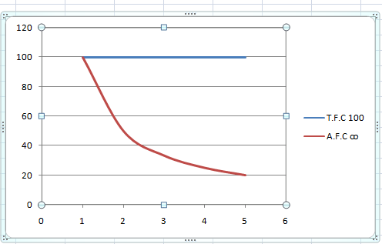

Slide 10
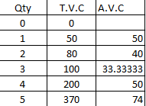
Average variable cost A.V.C = T.V.C/Q

Slide 11
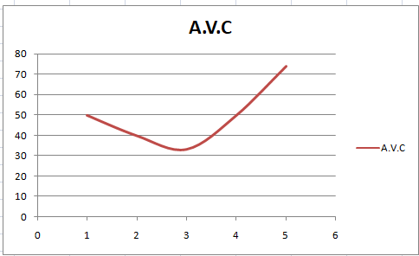

Slide 12
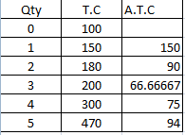
Average total cost A.T.C= T.C/Q

Slide 13
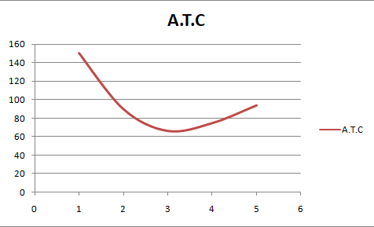

Slide 14
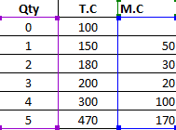
Mariginal Cost M.C= Change in T.C/Change in Qty.

Slide 15
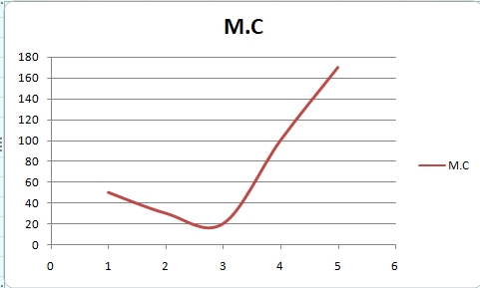

Slide 16
Calculate T.F.C and T.V.C

Slide 17
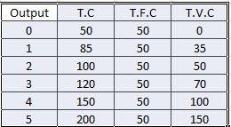

Slide 18

Find out the missing values from the given cost schedule:

Slide 19
